Slide 1
Computational Science @ Nexight Group
UB Symposium on Computational Science:
An Industrial and Carrier Perspective
Changwon Suh, Nexight Group
4/1/2016

Slide 2
For the next 70~80 years of YOU
Your Goals
You must ask yourself
who you are,
what you value, and
where you want to be

Slide 3


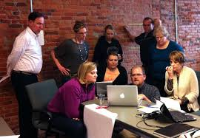

For the next 70~80 years of YOU
You must ask yourself
who you are,
what you value, and
where you want to be

Slide 4
Career Background
M.S.
Ph.D.
R&D team
@ Samsung-Corning
Ceramic Division
@ National Institute of
Standards and Technology
Materials Genome,
Materials Informatics, &
Integrated Computational Materials Engineering
@ Rensselaer Polytechnic Institute
→ Iowa State Univ.
Computational Science Center
@ National Renewable Energy Laboratory
From
Experimentalist
& Engineer
To
Technical Consultant
Computational Materials
Scientist
Flow battery research team
@ Harvard University
Technical consulting @ Nexight Group

Slide 5
Nexight Group
at a Glance

Slide 6
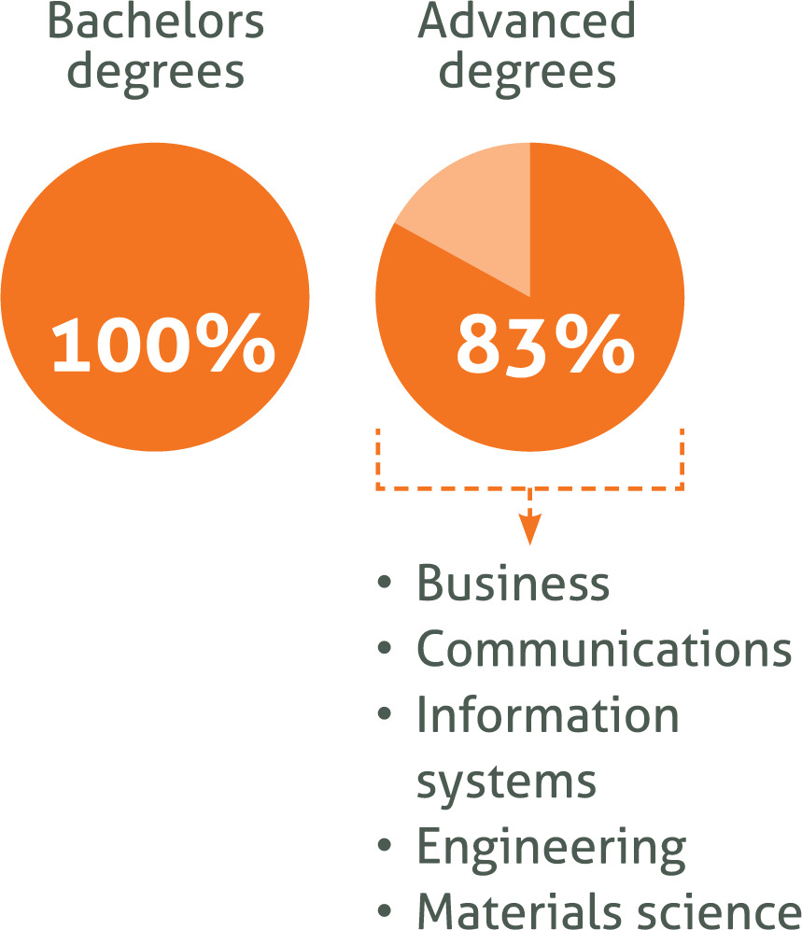
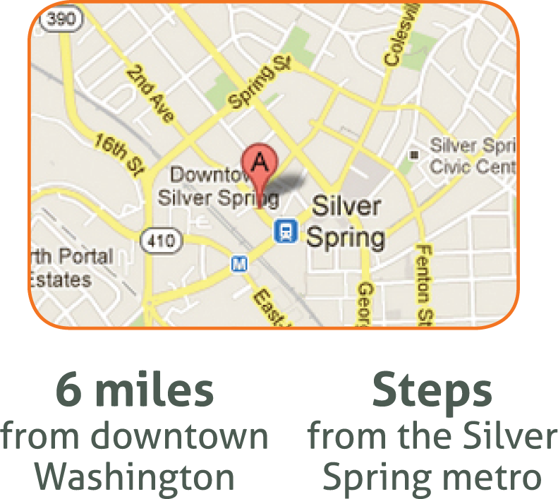
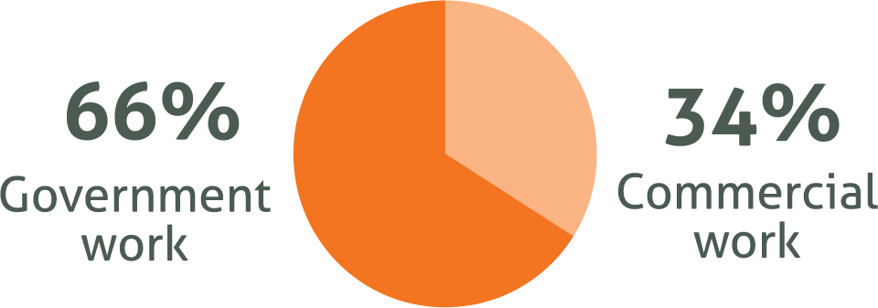
About Nexight Group
Nexight Group is a management and technical consulting firm.
22 full-time professional staff
$5.5 million in sales (2015)
Offices located in Silver Spring, MD
(D.C. Area)
22 full-time professional staff

Slide 7






Topical Expertise

Slide 8
Some of the Nexight Clients
Academic Clients
Georgia Institute of Technology, Johns Hopkins University, Energy Research
Institute at Nanyang Technological University, Penn State University,
Rutgers University, Worcester Polytechnic Institute
Commercial Clients
ACTA Materialia, American Ceramic Society, American Chemistry Council, American
Society of Mechanical Engineers, ASM International, Carbon War Room, Edison
Electric Institute, Electric Power Research Institute, Georgia Research Alliance, …
Government Clients
U.S. Department of Agriculture, U.S. Department of Commerce, U.S. Department
of Energy, U.S. Department of Health and Human Services, U.S. Department of
Homeland Security, National Climate Change Secretariat, Singapore, National
Energy Technology Laboratory, National Institute of Standards and Technology,
Sandia National Laboratory, …

Slide 9
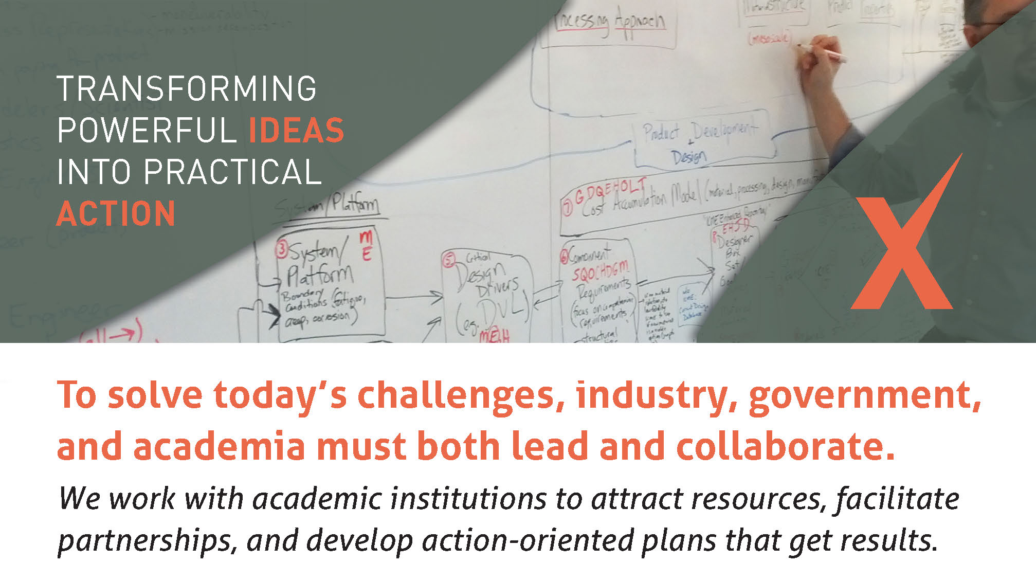
Nexight’s Approach

Slide 10
Nexight’s Approach
Today’s challenges require the collective insights of diverse leaders.
Our specialized collaborative planning and partnership techniques convene the right experts to solve complex problems.
Nexight Group staff have 20+ years of experience leading 500+ collaborative planning sessions across many sectors and countries.
Nexight Group’s research and analysis supports critical decision making and our award-winning communications move solutions forward.

Slide 11
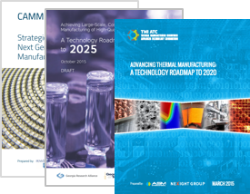
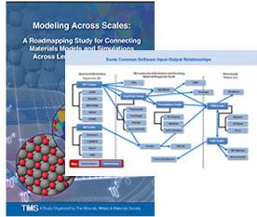
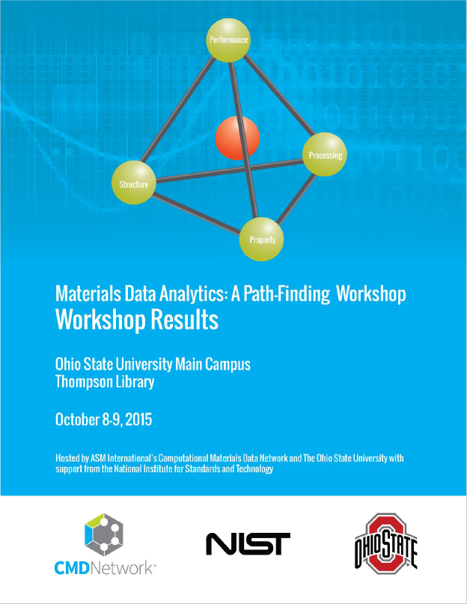
Sample Projects: Computer-related Engineering
NIST (National Institute of Standards and Technology)
Advanced Manufacturing Technology Roadmaps
Facilitating national initiatives to develop and deploy advanced manufacturing technologies
TMS (The Minerals, Metals & Materials Society)
Advanced Materials Roadmaps
Supporting the acceleration of cost-effective materials design with multiscale modeling
Materials Data Analytics Landscape Analysis
Understanding the data types, algorithms, tools, and methods used for materials data analytics
It is all about computer science, materials science, and data science!

Slide 12
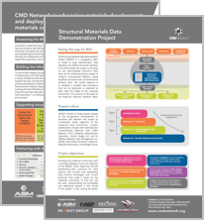

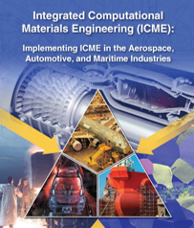
Sample Projects: Computer-related Engineering
ASM(American Society for Metals)
Materials Data- and Information-Sharing Network
Driving the development of public- and private-sector projects to generate needed materials data
ASME (The American Society of Mechanical Engineers) Advanced Manufacturing Environmental Scan
Developing an understanding of the advanced manufacturing environment for a professional society
TMS
Guide to Implementing ICME (Integrated Computational Materials Engineering)
Accelerating product development through cross-industry implementation of ICME

Slide 13
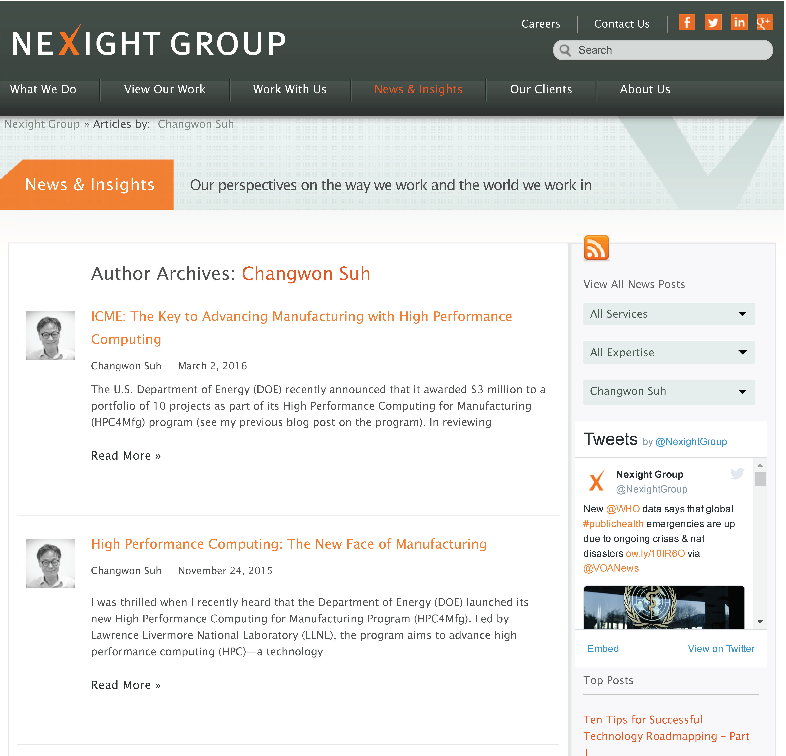
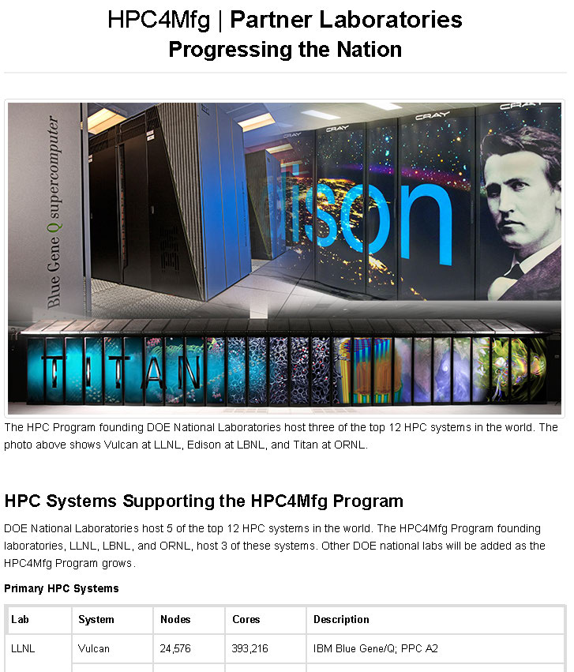
Nexight’s High Performance Computing Efforts
http://nexightgroup.com/author/csuh/
https://hpc4mfg.llnl.gov/

Slide 14

Nexight is looking for SMART people with a PASSION for
tackling important and challenging problems.
Sound like you?
http://nexightgroup.com/about-us/careers/

Slide 15
Future of You
Your profession growth
?
?
The only way to do great work is to love what you do. – S. Jobs

